Slide 1
Part Consolidation Candidate Detection for Additive Manufacturing
This is the template

Slide 2
Part Consolidation Candidate Detection for Additive Manufacturing
This is the template

Slide 3
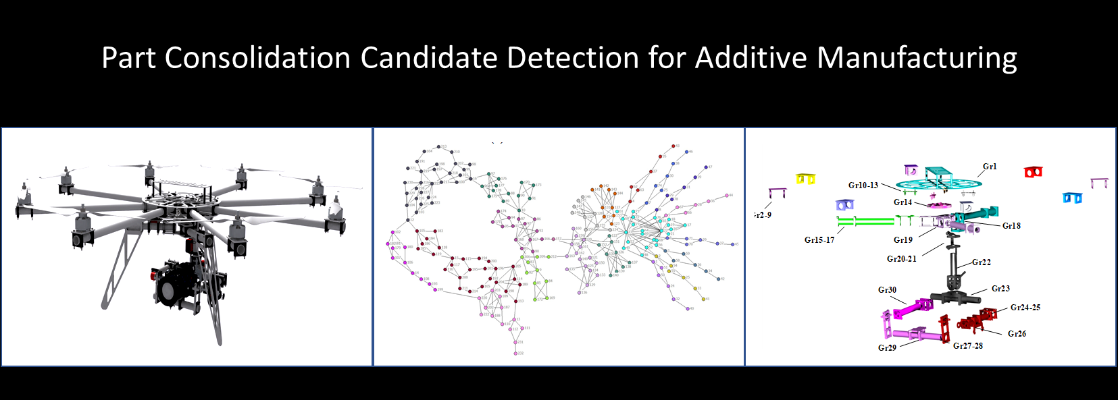

Slide 4
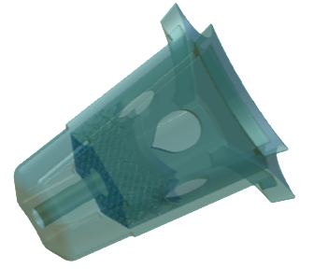
Part Fusion with Additive Manufacturing
7 parts in 1
25% weight savings

Slide 5
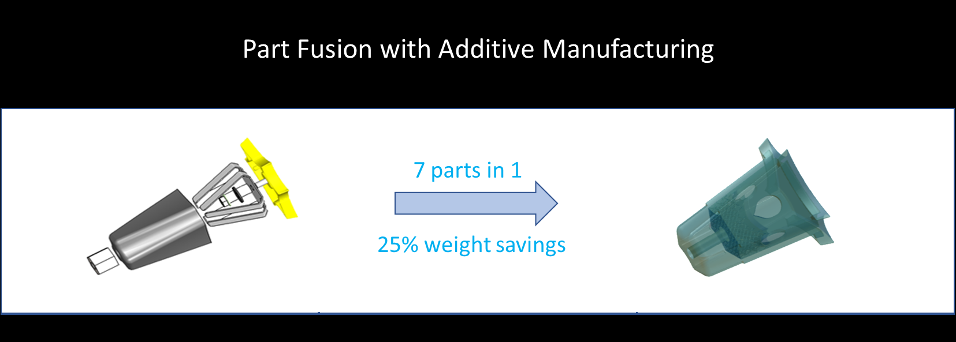

Slide 6
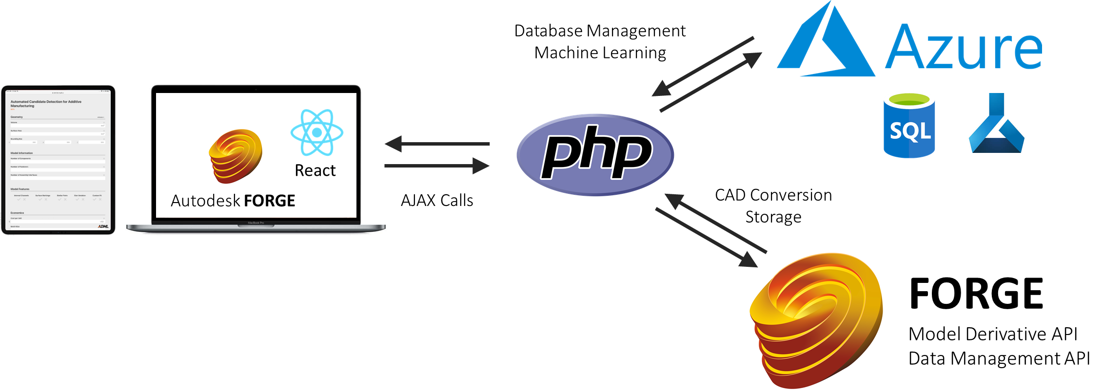
Architecture for Automated AM Candidacy Detection

Slide 7
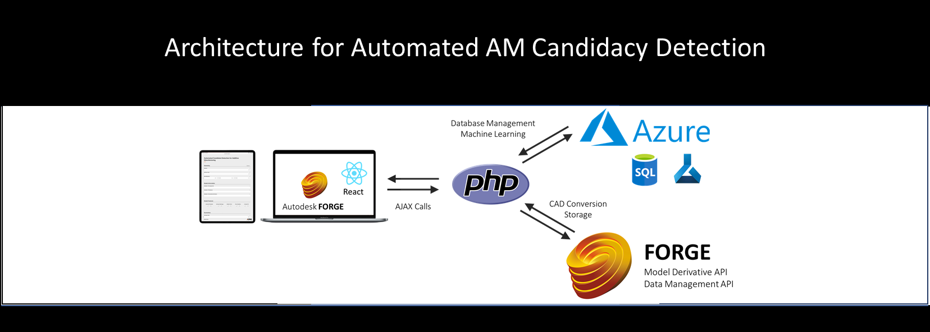

Slide 8
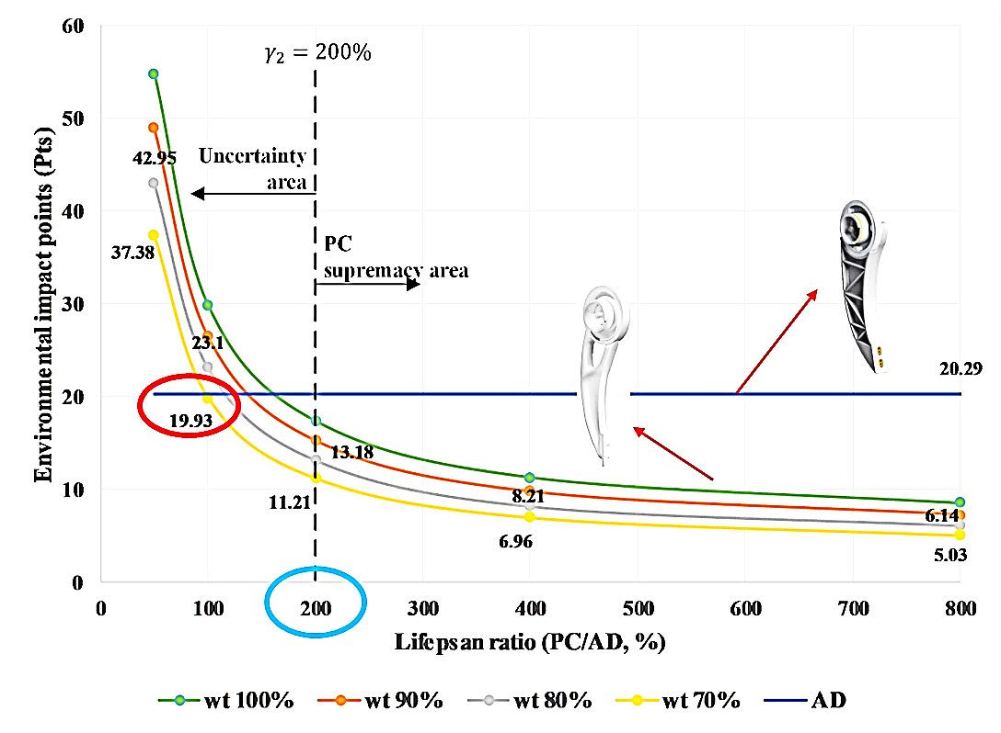
Sustainable Additive Manufacturing with Part Consolidation

Slide 9
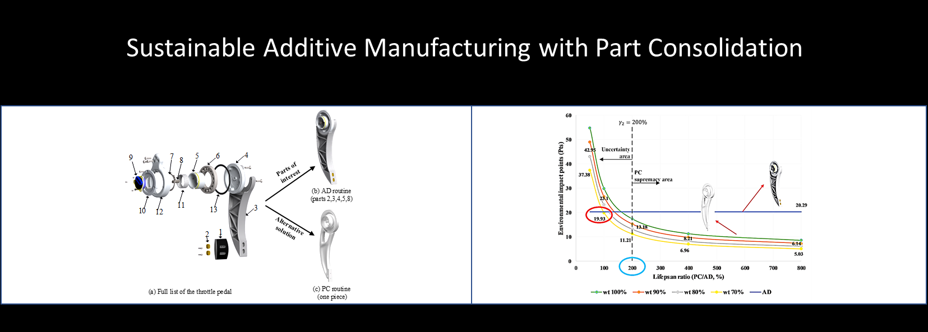

Slide 10
